Slide 1
Cross Platform Application Development
Assignment
Title: Laundry Application
Group - 8 (2Y-A)
Srijani Chakraborty(2022SP93013)
Bhumika Bhandari(2022SP93052)
Supriya Jagtap(2022SP93053)

Slide 2
Introduction of the Laundry App
Our laundry app is itself an unique app as in the market it has very less competitors with limited features. It’s a react native app which is currently running seamlessly on both Android and ios.
We made the UI simple and interactive as much as possible.
In this app we can easily login with our credentials and avail the laundry services and book our orders with proper pick-up details and suitable instructions.

Slide 3
Interesting Features
Centralised login and registration with proper validation.
Screens: Login, Registration, Home, Service, Profile, Pickup, Cart, Booking.
Current location access with Google map.
Search functionality.
Service detail page.
Easy quantity increase and decrease feature.
Add to cart and pick up details feature.
Easy navigation between screens.
Easy UI.
Special instruction facility in order details.
Pick up details validation.
Order booking with animation.
Profile page with current order details.

Slide 4
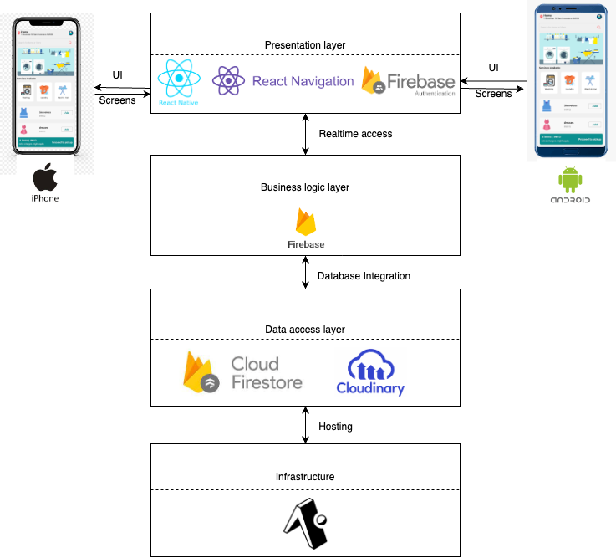
Architecture
User Interface(UI):
react-native
Routing:
react navigation
Authentication:
Firebase centralised authentication
Database:
Firebase realtime database which is known as FireStore
Cloud storage for images:
Cloudinary
Hosting:
Expo Store

Slide 5
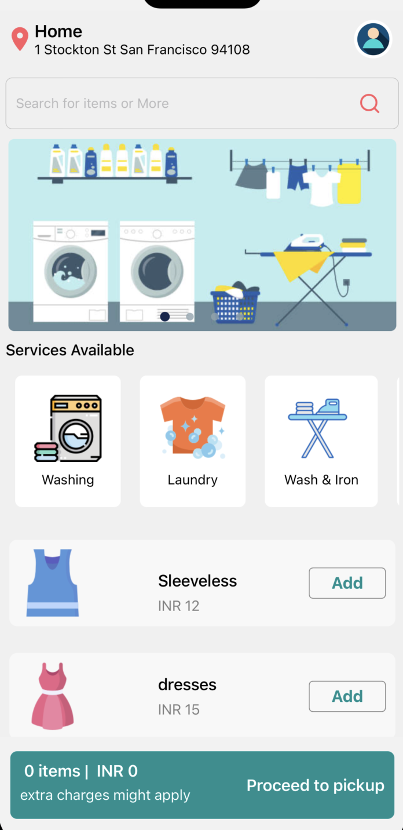
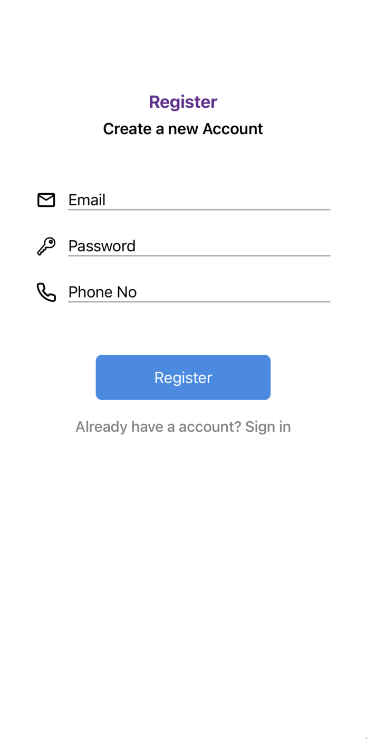
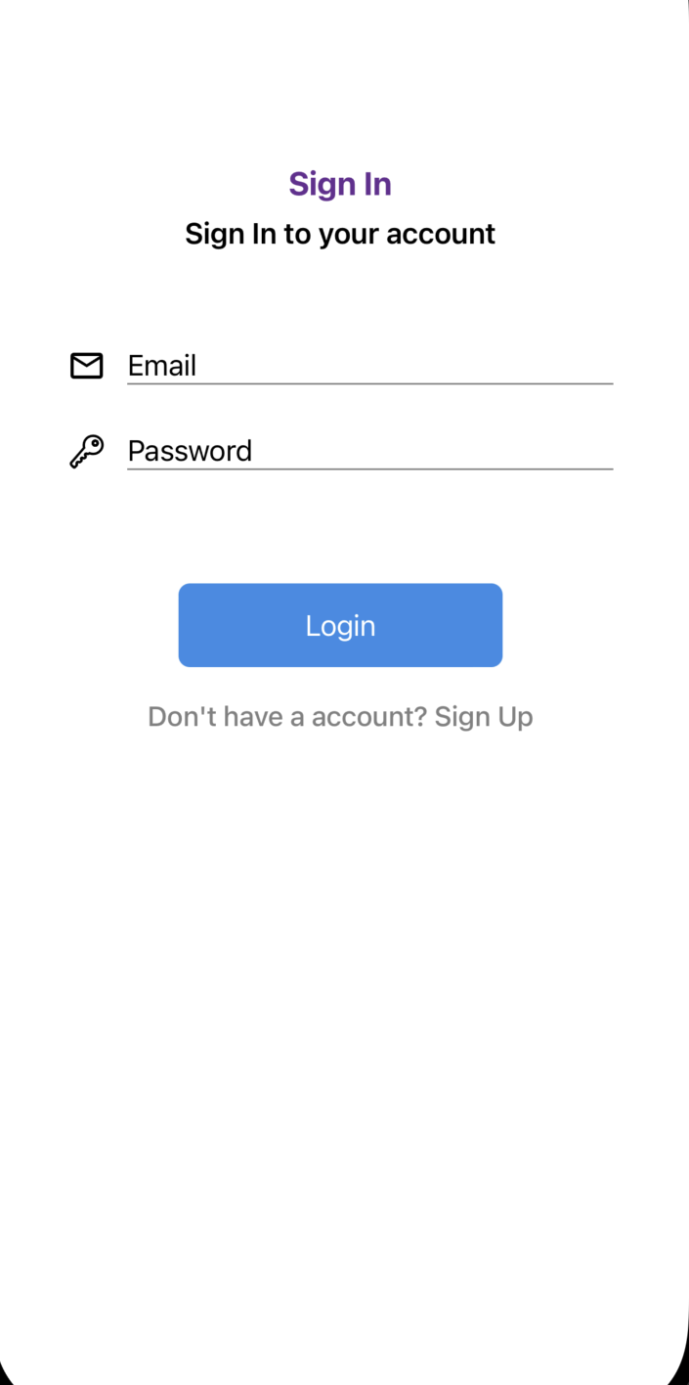
Screenshots
Login
Register
Home

Slide 6
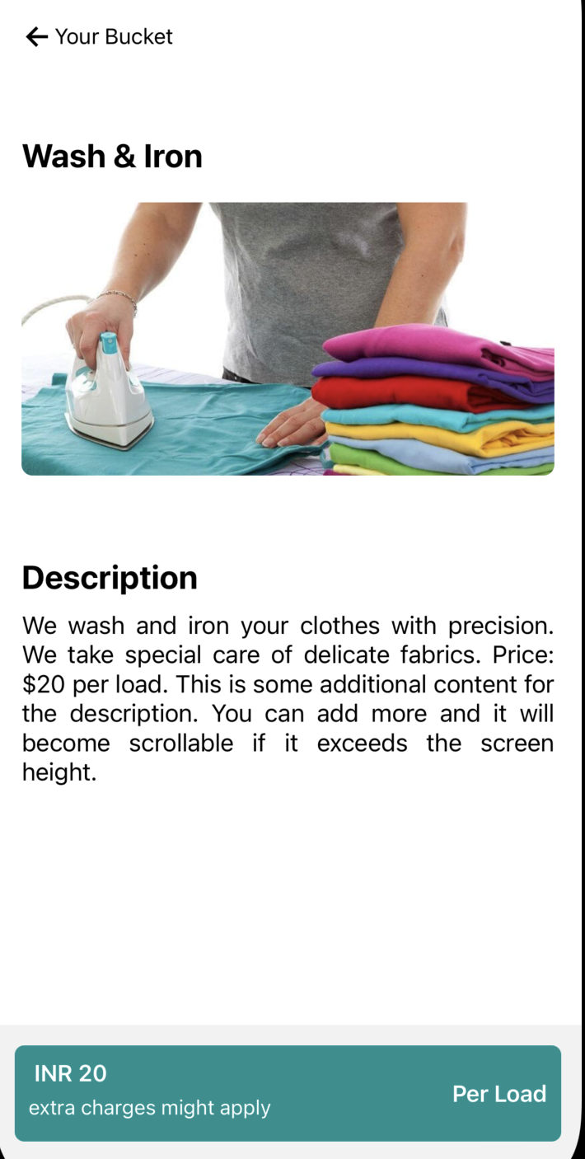
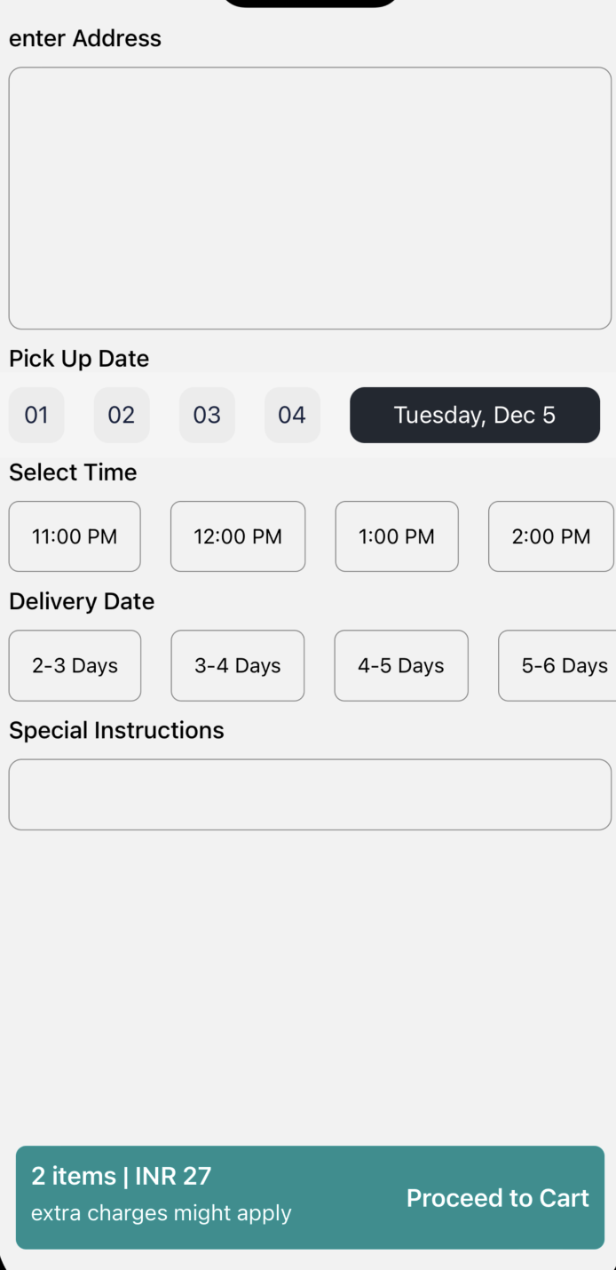
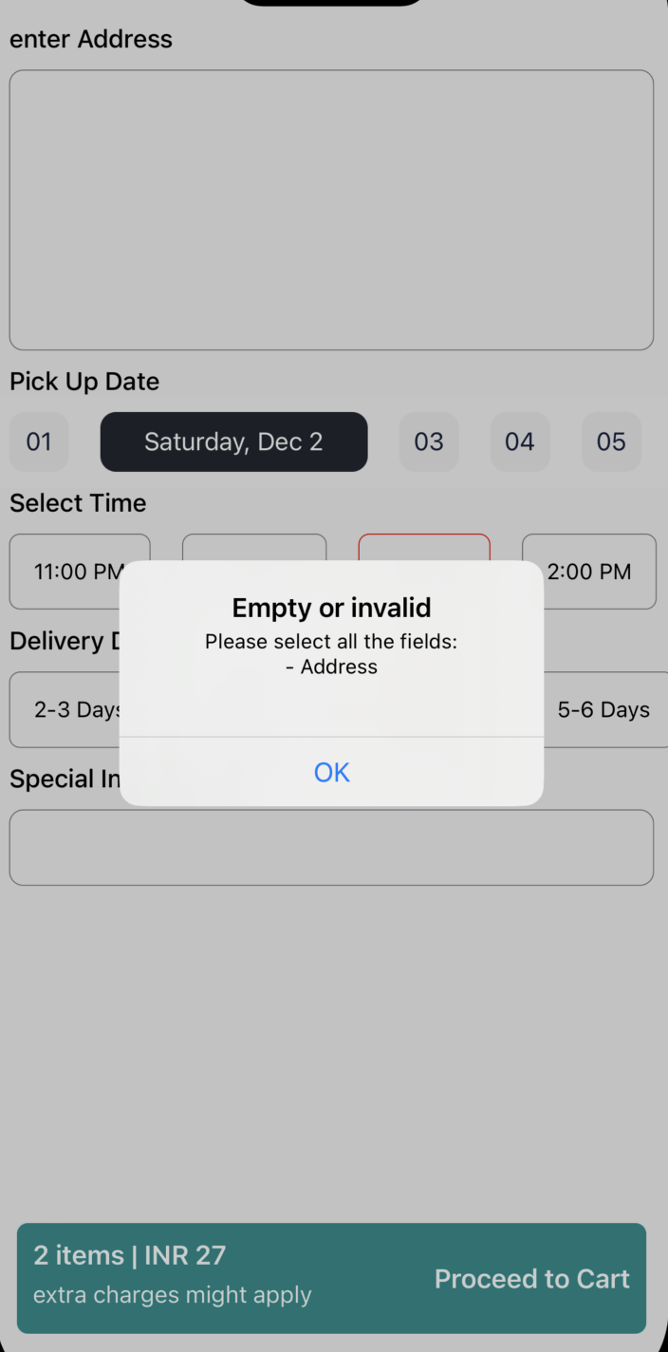
Service
Pickup
validation

Slide 7
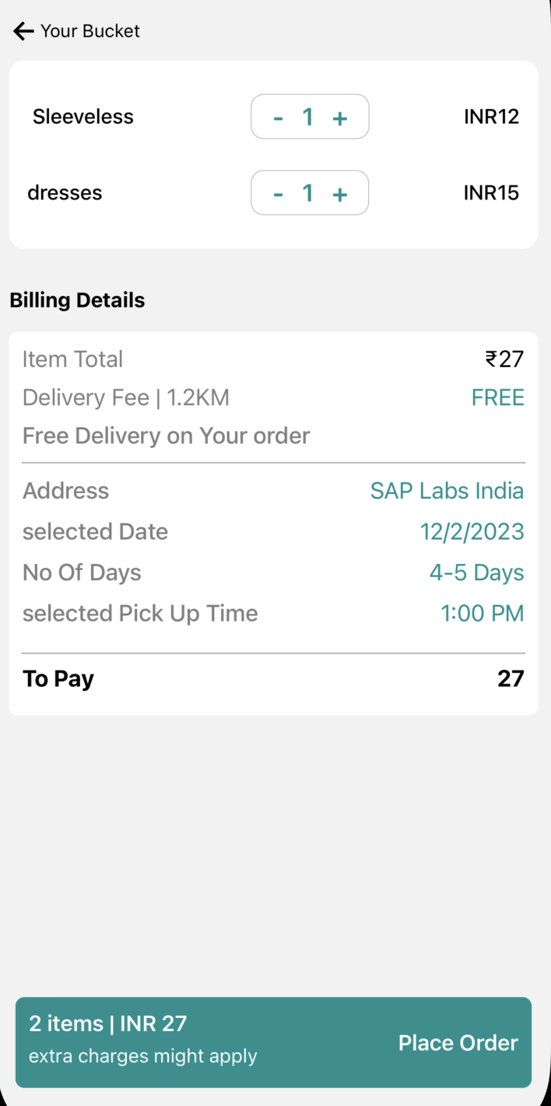

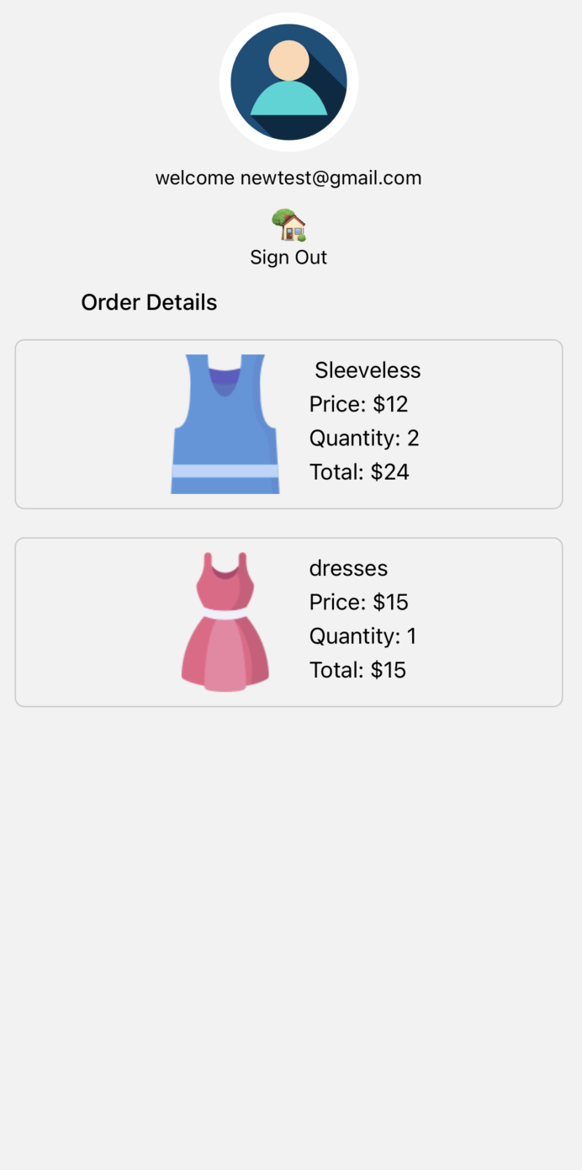
Challenges
Cart
Order
Profile

Slide 8
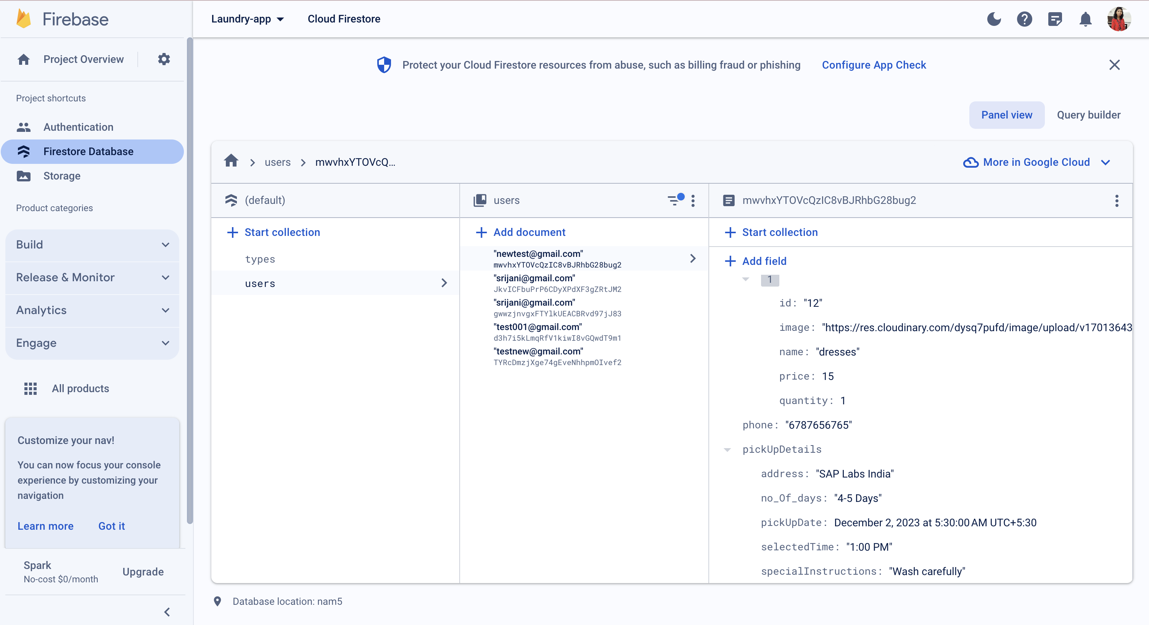
DataBase

Slide 9
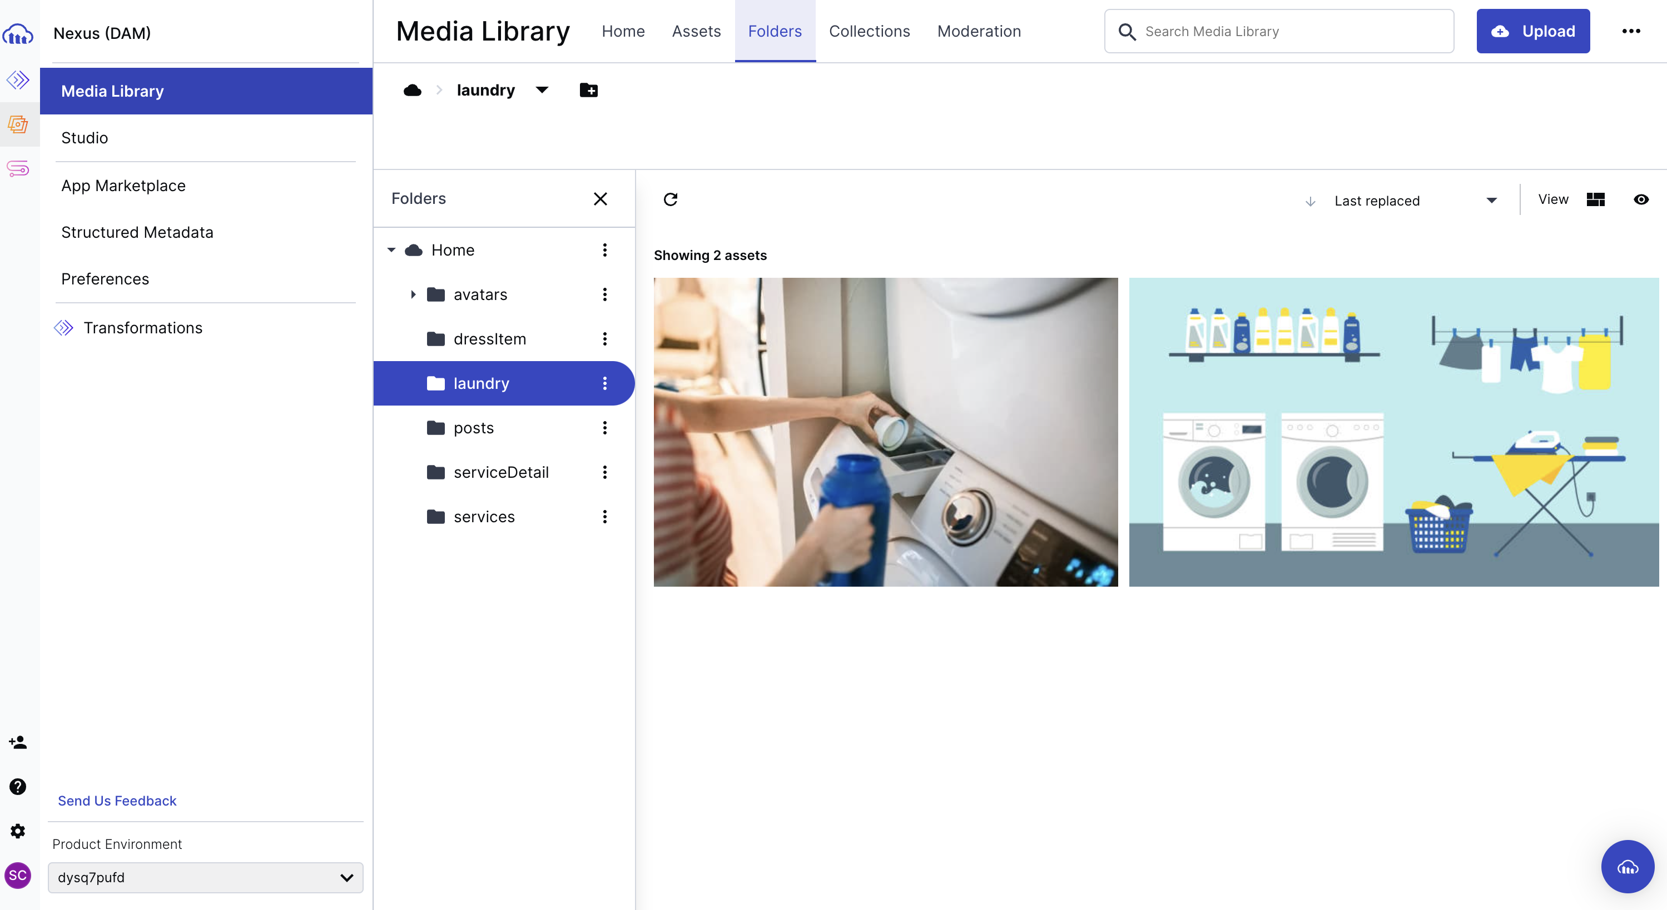
Cloudinary

Slide 10
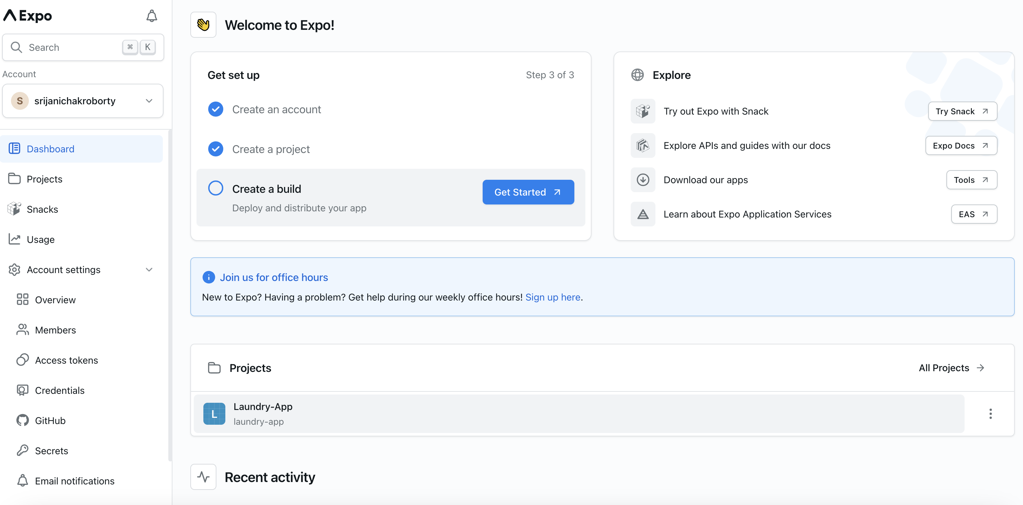
Hosting

Slide 11
Challenges
Choosing the proper techstack.
Interactive UI design.
Learning new technologies and implementing them.

Slide 12
Futute extensibility
We can add payment gateway.
Integrating with message service.
Update and delete order functionality.
Enhancement in profile page.
Live delivery and pickup tracking.

Slide 13
THANK YOU

